Slide 1


Dependable DevOps
Reaching Real Production Goals
Field CTO at Octopus Deploy
@bobjwalker
bob.walker@octopus.com

Slide 2
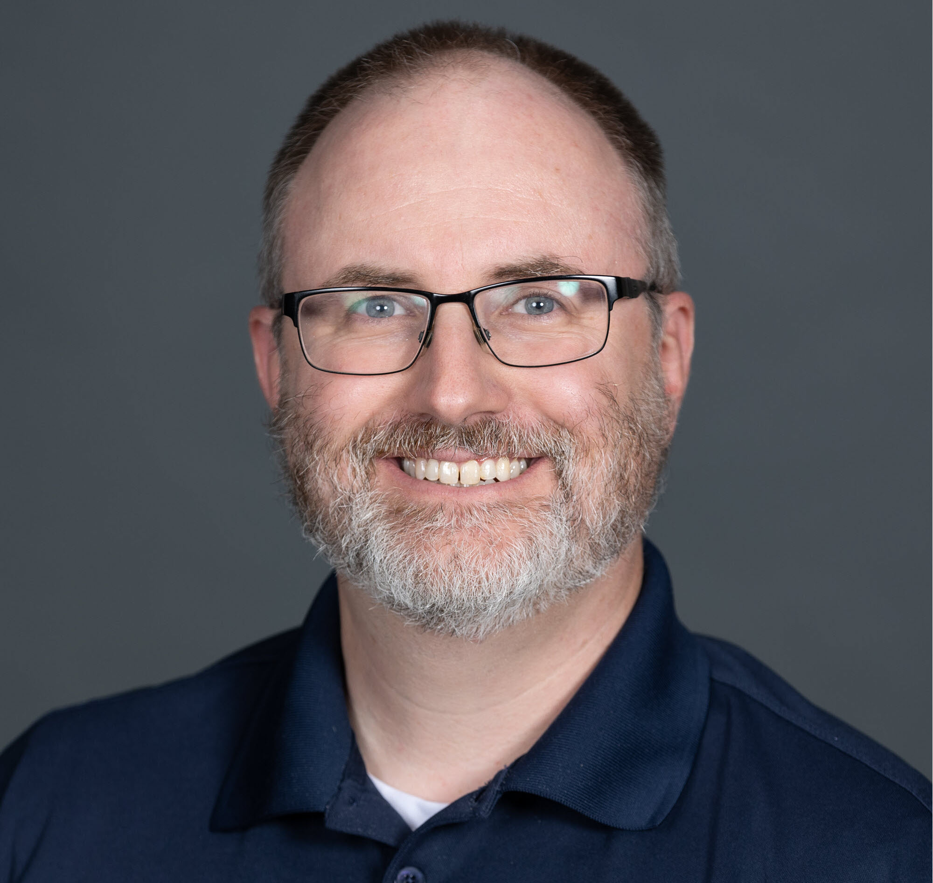
Bob Walker
Field CTO
Octonaut since 2018
@bobjwalker
bob.walker@octopus.com

Slide 3







Slide 4


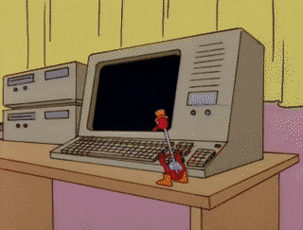

Slide 5
Outline
Unrealistic Goal
Initial Success Hubris
DevOps Intro
Considerations
Realistic Goals

Slide 6

Don’t be like me
Past

Slide 7



Slide 8
Unrealistic Goal
Deploying to Production every day in the middle of the day with zero-downtime
(For my application)

Slide 9


Slide 10

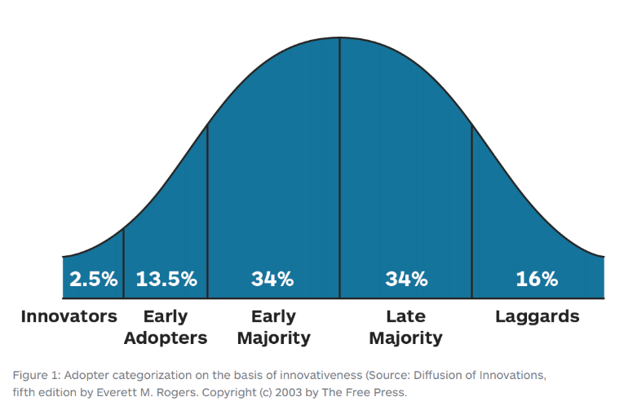
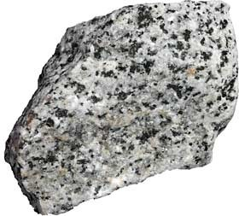

Slide 11
In the next two years my plan is we will be able to push to production multiple times a day - me

Slide 12

Deployment Window
Bankers hours
Monday - Friday
7 AM - 6 PM US Central Time
Normal Deployment window
Monday - Thursday + weekends
7 PM - 6 AM
Image Source: https://www.simplus.com/choose-right-deployment-strategy/

Slide 13

Application Overview
Internally developed loan origination system used by 2k+ people
Business Rules
Auto-approval and manual verification
Resubmission triggered an automatic manual verification
Image Source: https://fcsamerica.com

Slide 14
User Roles
Loan Officers
Underwriters
Booking Specialists
Finance Officers
Risk Analysts
Auditors

Slide 15
Just need to implement
DevOps Practices

Slide 16
Initial Success Hubris

Slide 17

Success

Slide 18
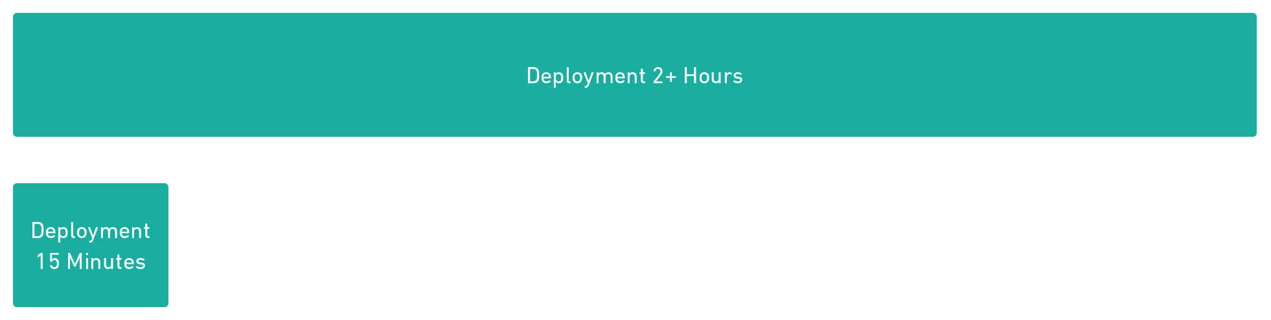
Success

Slide 19






Slide 20
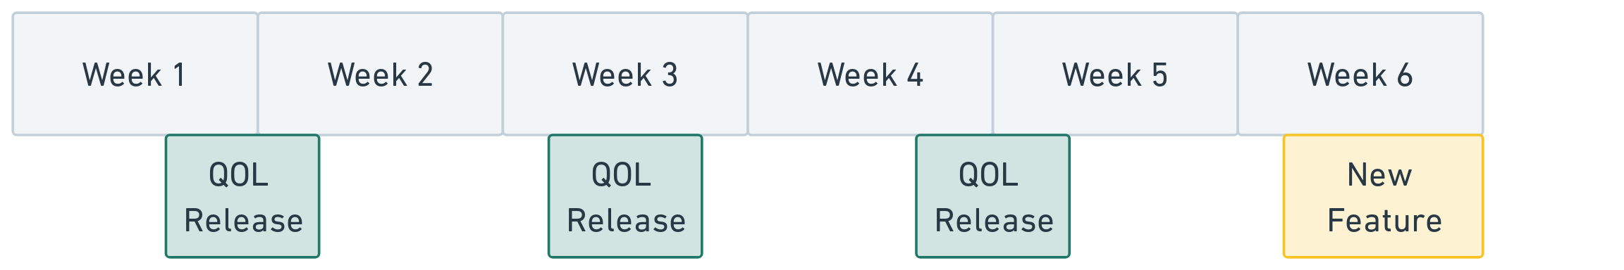
Release Schedule

Slide 21
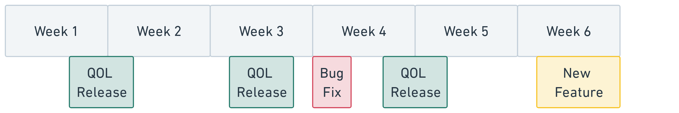
Release Schedule

Slide 22
Several months of iterative improvements to go from 2+ hours to ~15 minutes

Slide 23
Users are going to love every day then!

Slide 24
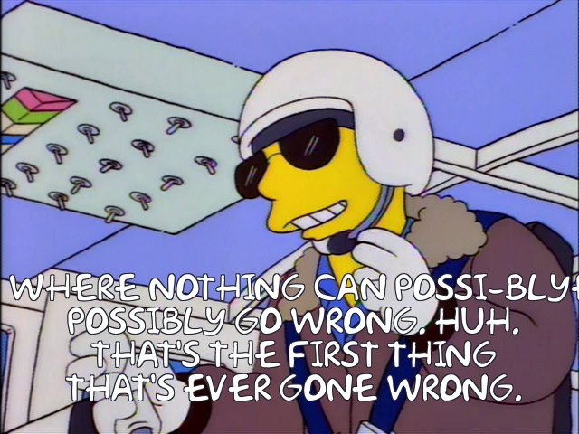
Image Source: https://frinkiac.com/caption/S06E04/441657

Slide 25
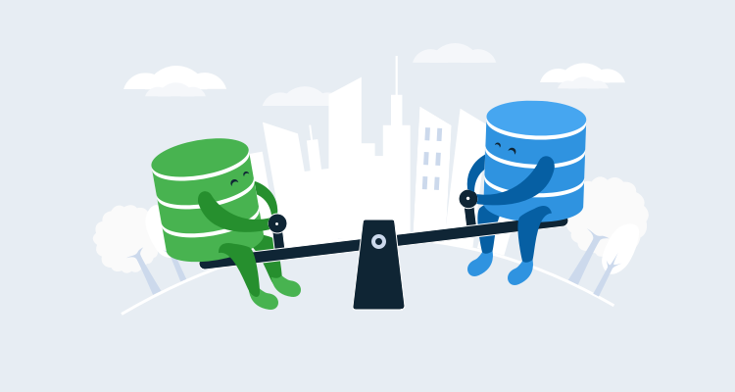
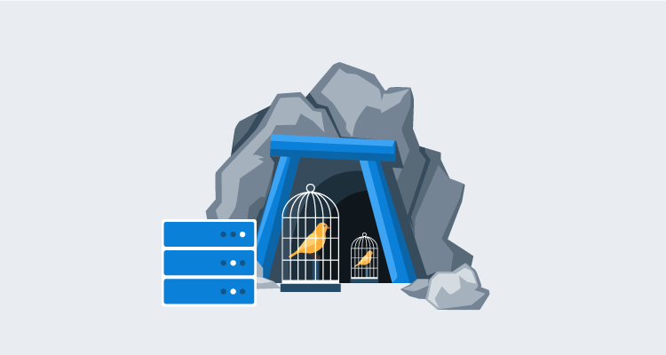
Blue Green
Canary

Slide 26
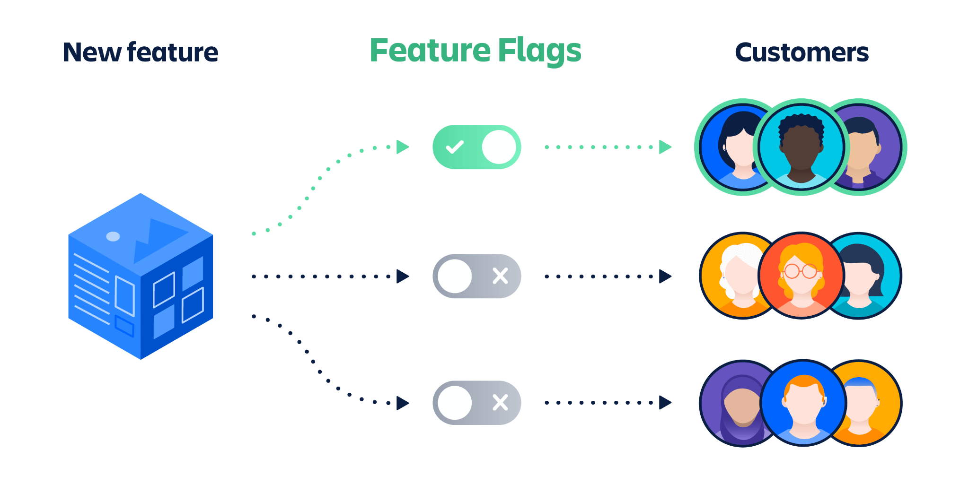
Image Source: https://www.atlassian.com/continuous-delivery/principles/feature-flags

Slide 27
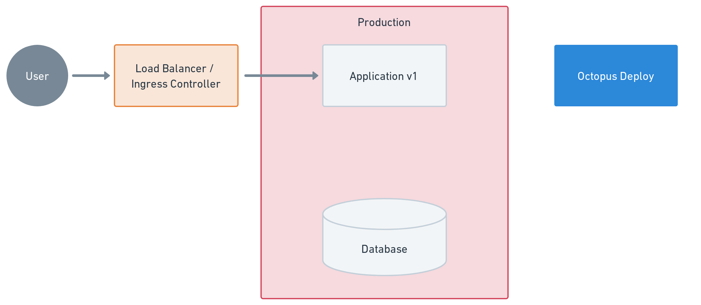

Slide 28
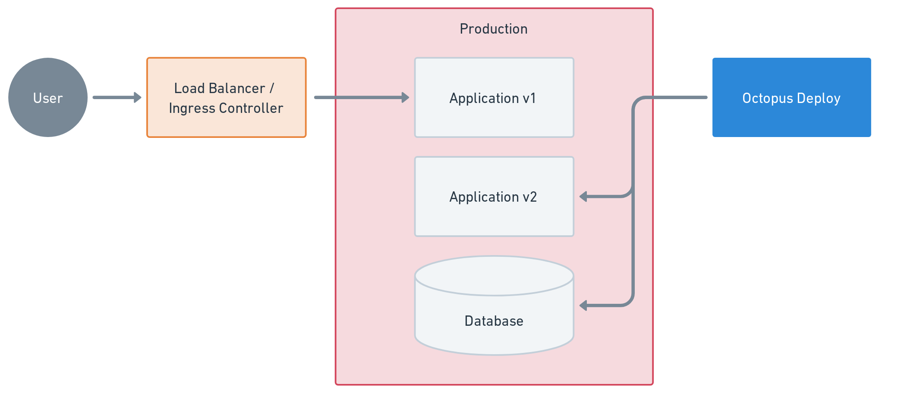

Slide 29
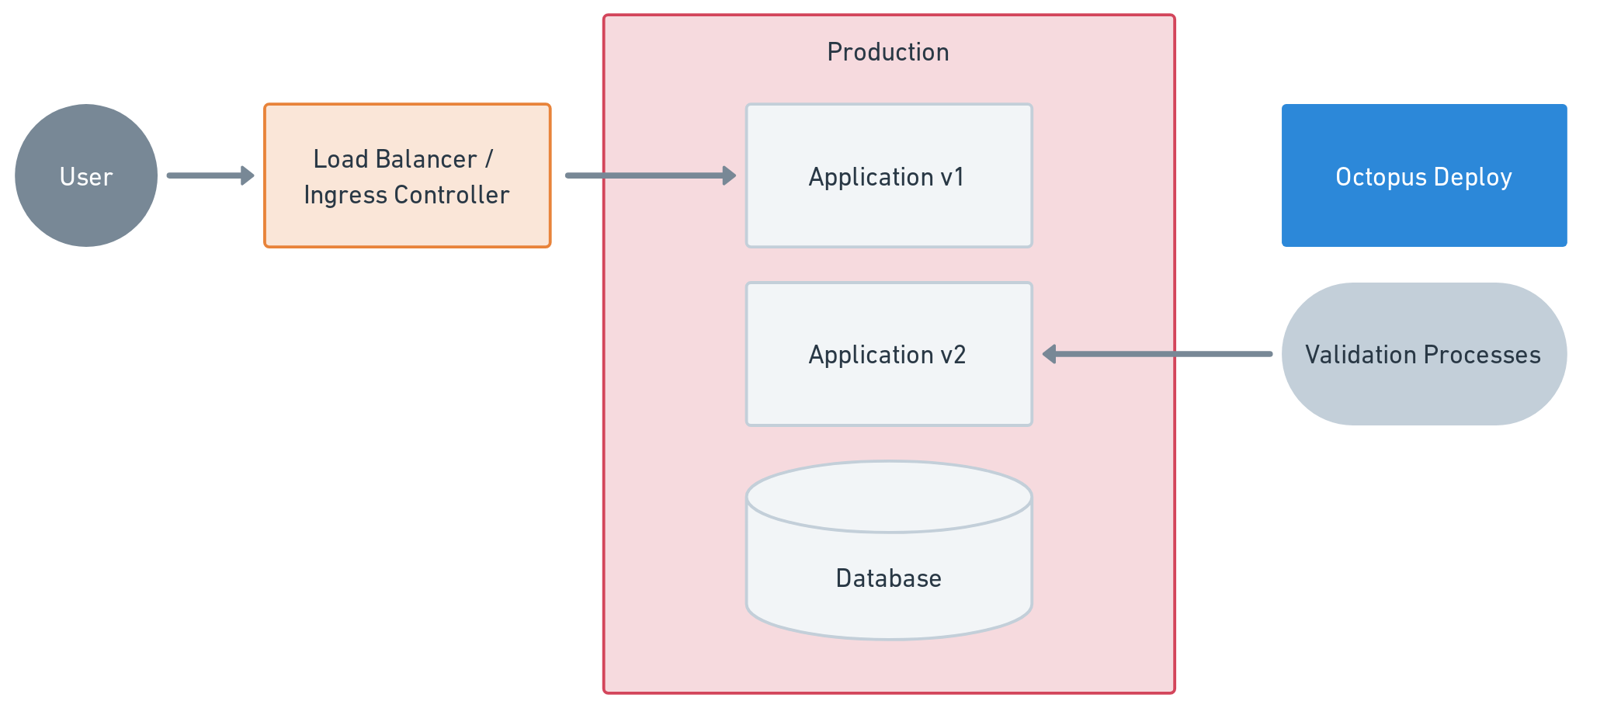

Slide 30


Slide 31
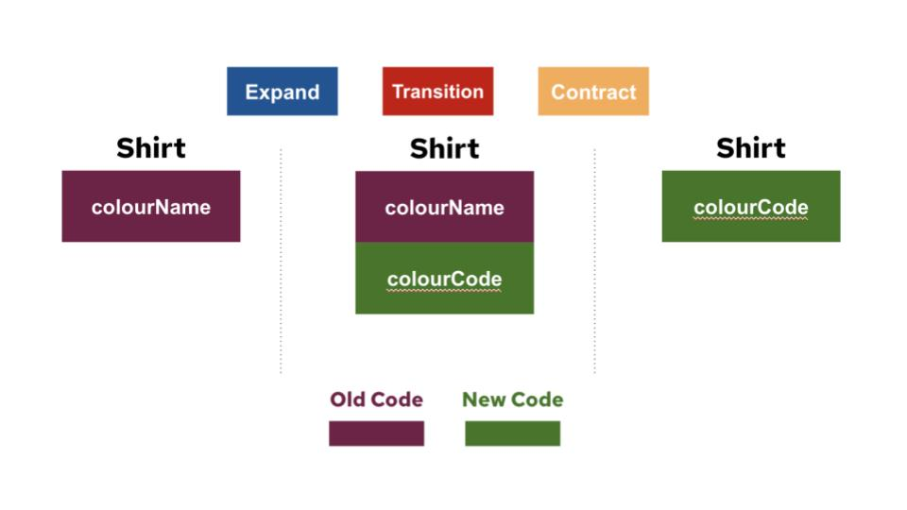
Expand and Contract Pattern
Deployment #1 - Add ColourCode Column to DB
Deployment #4 - Remove ColourName column from DB
Deployment #2 - Update code to read / write to both columns
Deployment #3 - Remove code that writes to ColourName
Image Source: https://openpracticelibrary.com/practice/expand-and-contract-pattern/

Slide 32
Significant Investment
Infrastructure to host multiple copies of the application.
Create testing suite to support multiple copies and/or feature flags.
Training on new development techniques.
Code changes to support multiple copies.
Start developing new features.

Slide 33
Roughly same amount of effort and time as it took to go from
2+ hours to 15 minutes

Slide 34
Just one problem…

Slide 35
Loan Officers don’t want the application to change while they are helping customers

Slide 36


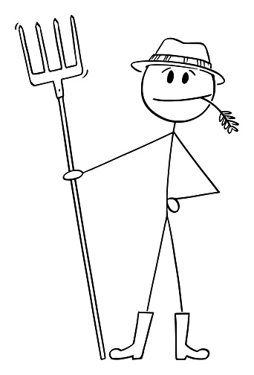
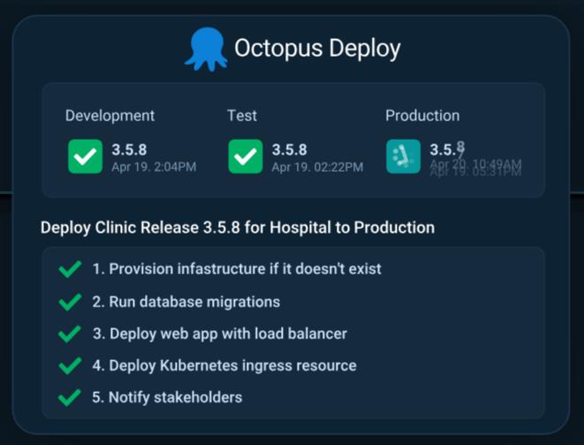
10 AM
Bob Walker
12 PM
Deployment
2 PM
Joe Walker

Slide 37
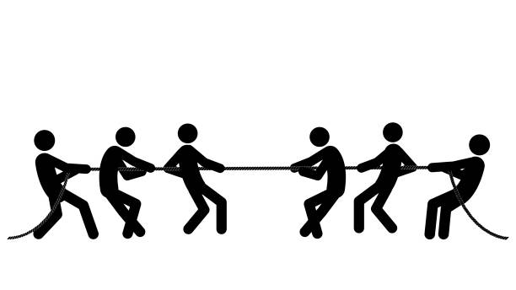
Changes
New Features
UI Changes
Users
Expectations
Muscle Memory
Training
Regular Day to Day

Slide 38
Release Schedule

Slide 39
Significant investment for people who didn’t want changes that fast

Slide 40
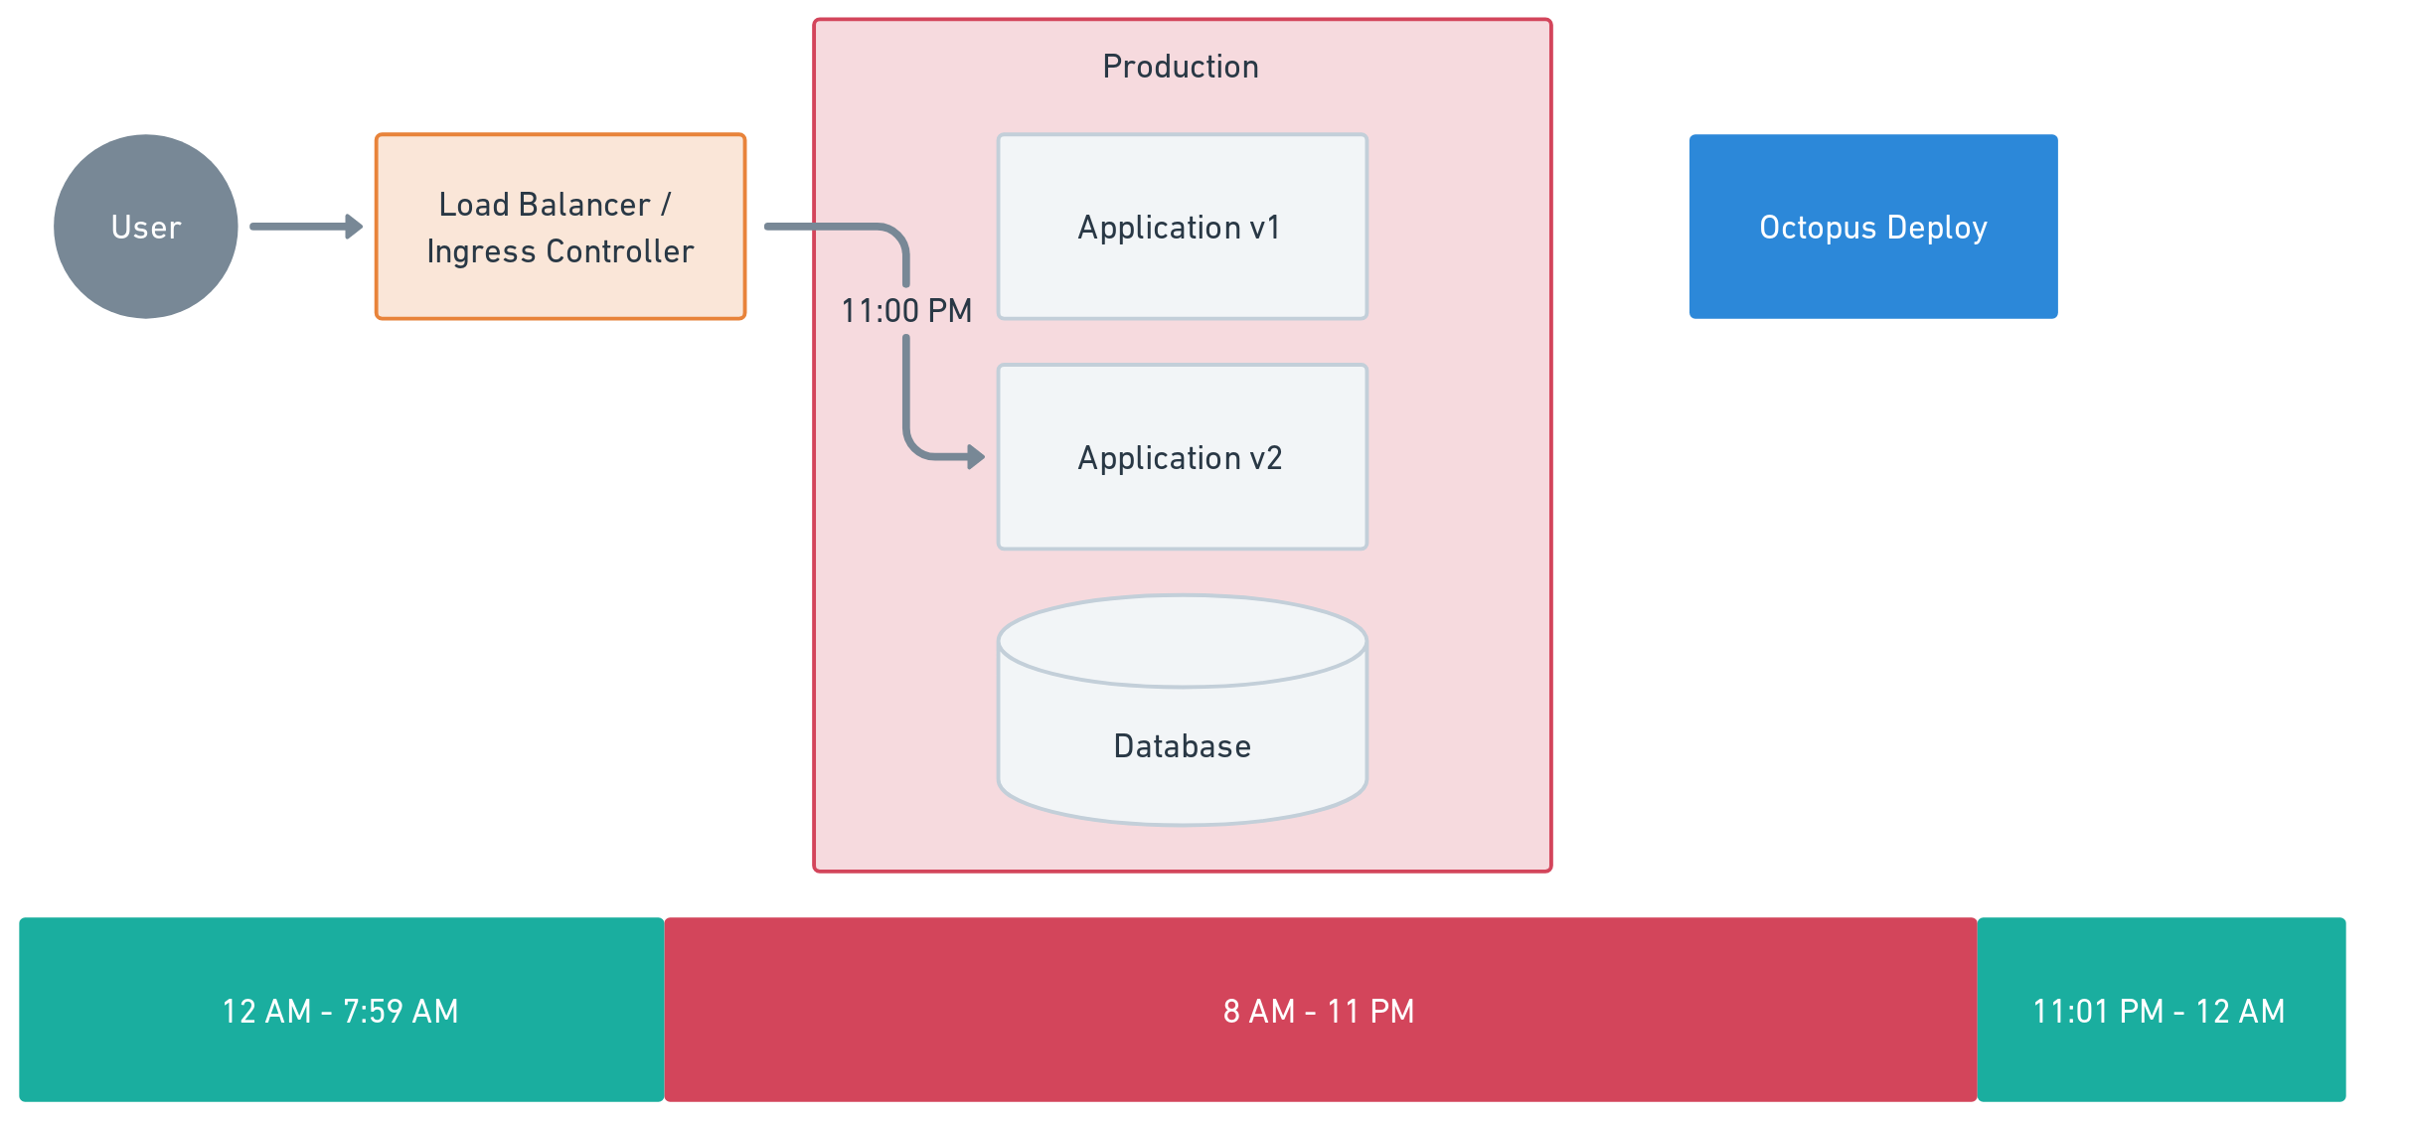
Release new changes off hours

Slide 41
Octopus Customer
Deploy their software suite to their customers every three weeks
Thursday - Schedule Deployments to Production
Saturday - Deploy SaaS backend
Monday - Deploy to customer’s locations
Octopus Cloud Upgrade
Upgrade them Friday morning
One week memory leak slipped through
“It was working yesterday, why isn’t it working today?!?! We have a production deployment tomorrow!”

Slide 42
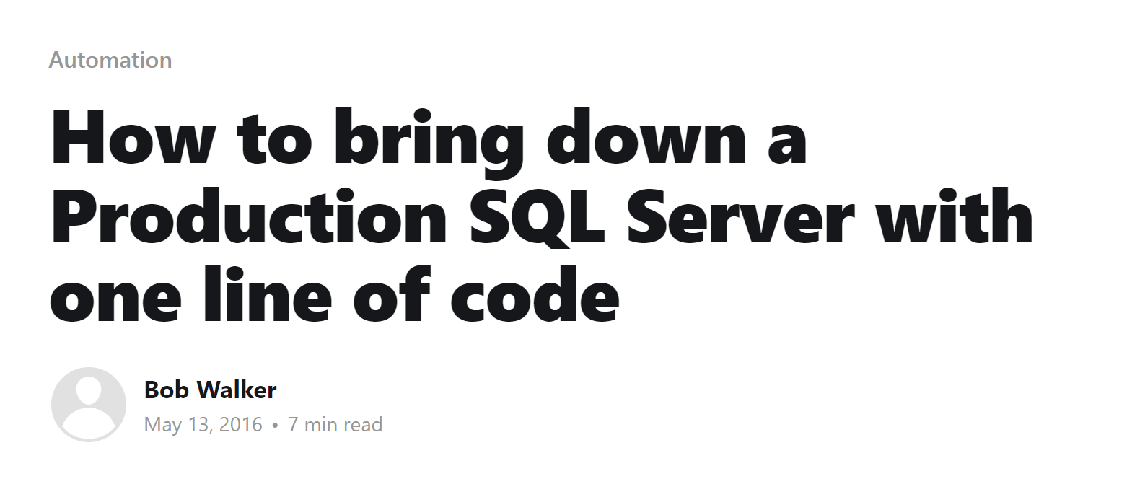

Slide 43


Slide 44
Can we justify the investment into
zero downtime deployments?

Slide 45
No

Slide 46



Slide 47
DevOps Intro

Slide 48
DevOps is practices and patterns that uses tooling enable Software Developers and Operations to solve problems together

Slide 49
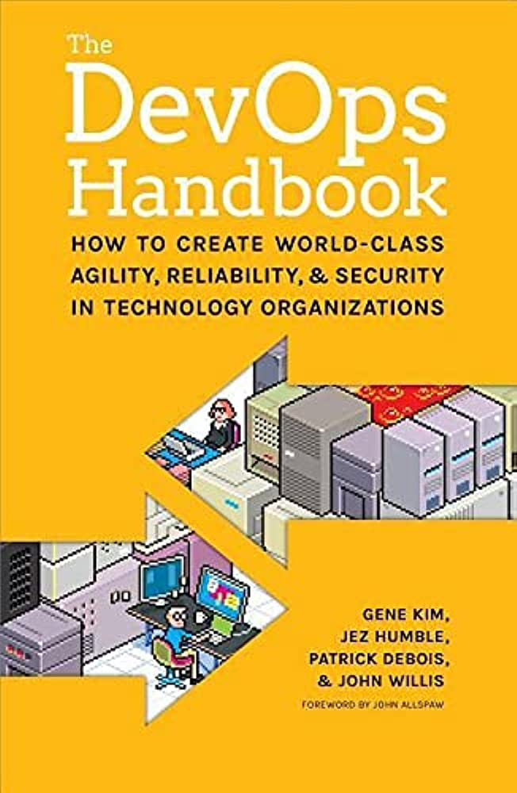

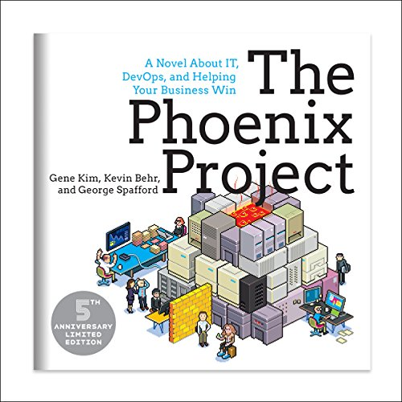
The DevOps Handbook + Phoenix Project
Improve the flow from Developers to Operations
Improve feedback in all stages
Continual learning and experimentation

Slide 50
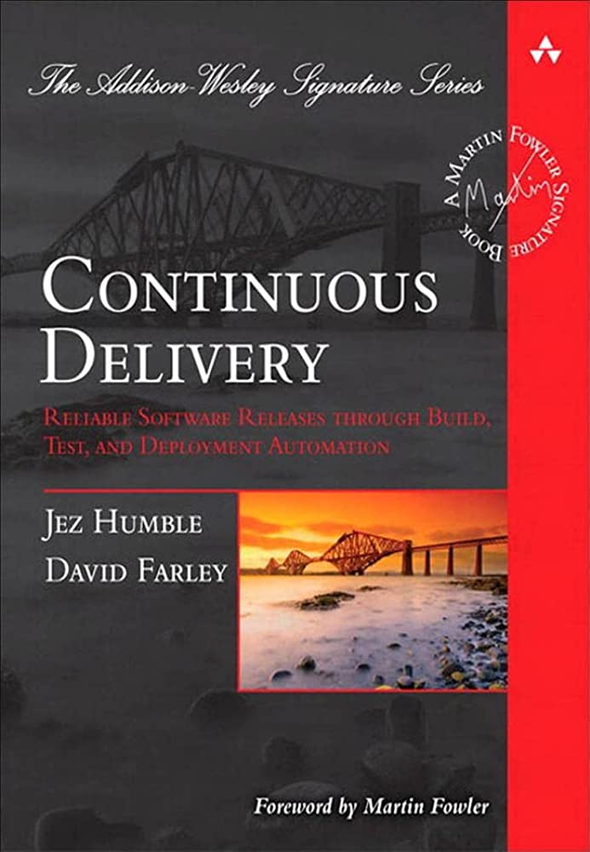
Continuous Delivery
One aspect of accomplishing DevOps goals
Main branch is always in a shippable state
Testing
Unit Testing
Integration Testing
Automation
Build Servers
Deployment Server
Running Unit and Integration tests
Deploy at a moments notice

Slide 51
Nowhere does it state I must deploy in the middle of the day with zero downtime

Slide 52
Not all applications are the same

Slide 53
Too easy to be preoccupied with improving an arbitrary numbers

Slide 54

DORA Metrics
Deployment frequency
Lead time for changes
Change failure rate
Mean time to recovery

Slide 55
Reducing deployment frequency and reducing lead time is critical

Slide 56
However, that shouldn’t come at the expense of our users

Slide 57
Considerations

Slide 58
Prioritization

Slide 59
Main should always be ready to deploy

Slide 60
Doesn’t mean you have to deploy right now

Slide 61
Questions to ask
Will my users benefit from this change?
What negative impacts will there be on my user base?
How will I train my user base?
Does the user traffic justify this change?
What regulations or contract restrictions are there?
Is my application architected to support this change?
Is there a higher priority item from the users or customer facing employees?

Slide 62
Application Types
Public facing
E-Commerce
Homepage
Critical Business Services
Logging Service
Authentication Service
Internal Applications
B2B or SaaS Multi-Tenant Application
Shared Instances
Isolated Instances

Slide 63
Features Released to User Base
Public facing applications - based on location or demographic
Internal Application - pilot then general adoption
B2B Application - per account / company

Slide 64

Training Impact
Public facing applications
Design / customer experience
Docs
Guided UI
Internal Application / B2B
Business rules
Process training
Workshops
Videos
Image Source: https://www.airswift.com/blog/five-ways-to-improve-training-and-development-in-the-workplace

Slide 65
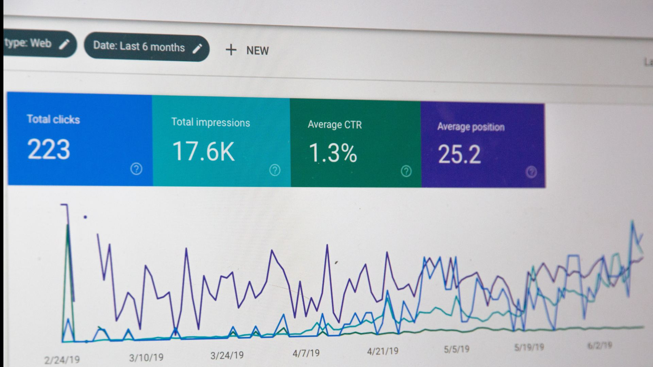
Traffic
Public
Millions of visitors 24/7/365
100k+ visitors Regional 18/5/250
B2B or SaaS Multi-Tenant
Isolated Instances 1k+ visitors 8/5/250
Shared Instances 500k+ visitors 20/7/330
Critical Events
Holiday Season
Super Bowl Sunday
Image Source: https://www.abtasty.com/blog/analyze-website-traffic/

Slide 66
Company Policies and Regulations
Laws and regulations
The person who made the change cannot approve or deploy the change
Audit history from change to Production
Contracts
Outage Windows
Customer must sign-off
Change approval boards
Business Owner Sign-Off
Test plans

Slide 67
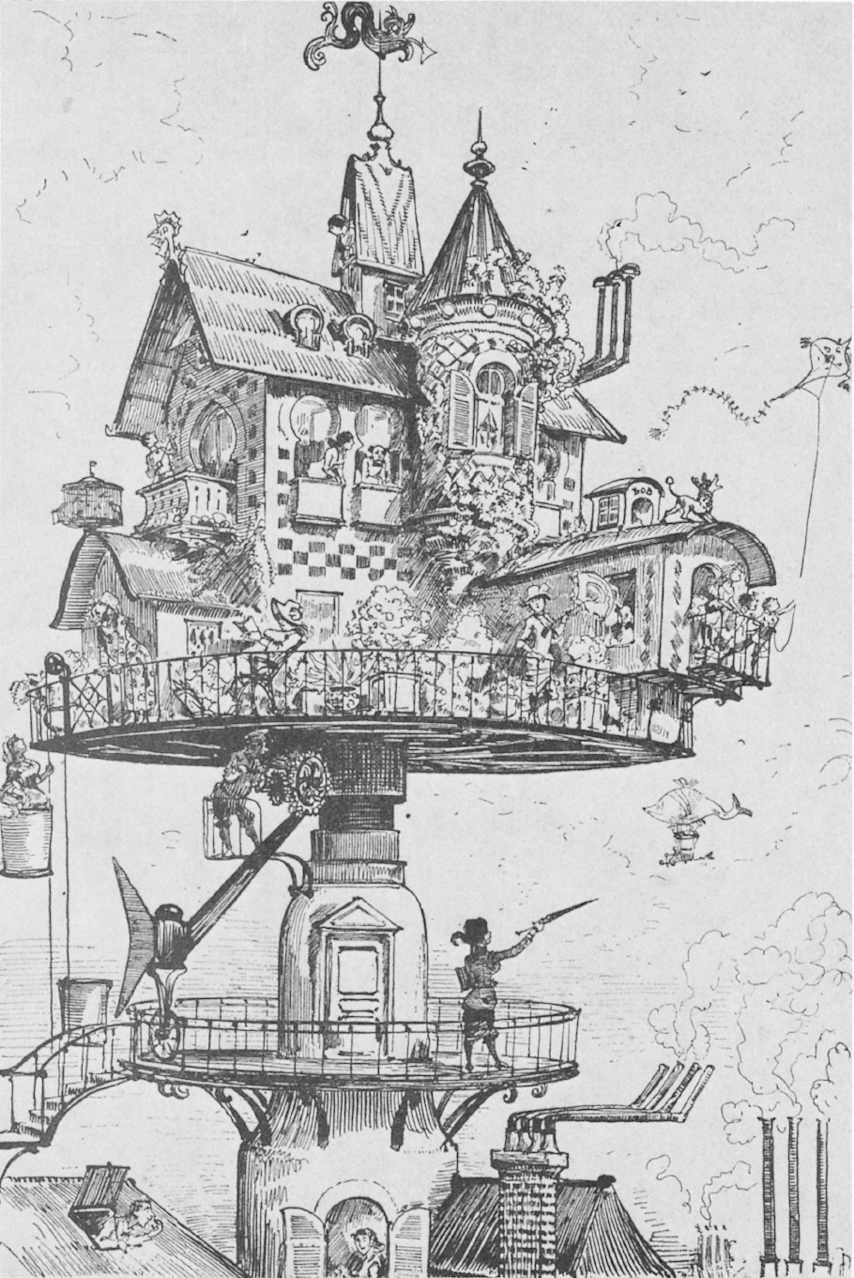
Application Architecture
Code / database interactions
Unnecessary component coupling
Coupling with external services
Required software or tooling to run
Patterns
Ability to support unit testing
Ability to support integration testing
Image Source: Mythical Man-Month by Fred Brooks ISBN 0201006502

Slide 68
Realistic Goals

Slide 69
Thinking back on it…

Slide 70
Realistic Changes
Make it easier to test / verify changes in branches
Eliminate unnecessary verification for unfinished work
Fully utilize all four environments (development, test, staging, production)
Better experience for users during deployments
“Maintenance Mode” OR All user traffic redirected to outage window notification
Feature flags to based on job role for new functionality
Prevent resubmission rule from triggering
Prevent bugs due to users accessing app during deployment

Slide 71
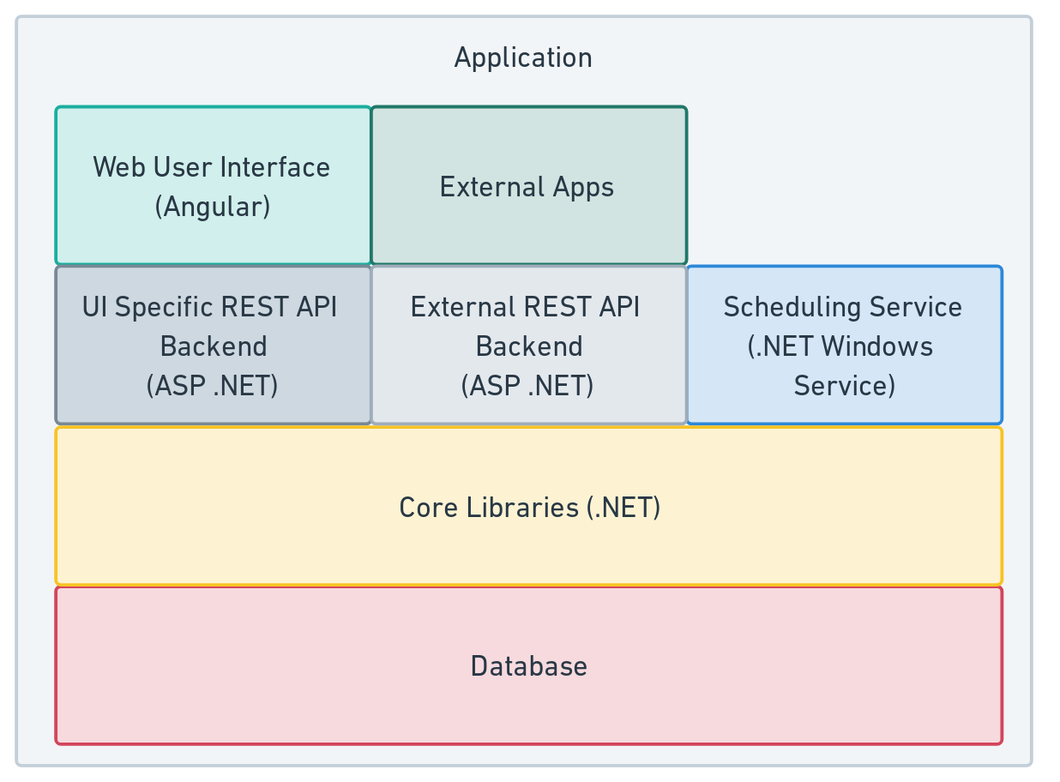
Application Architecture

Slide 72
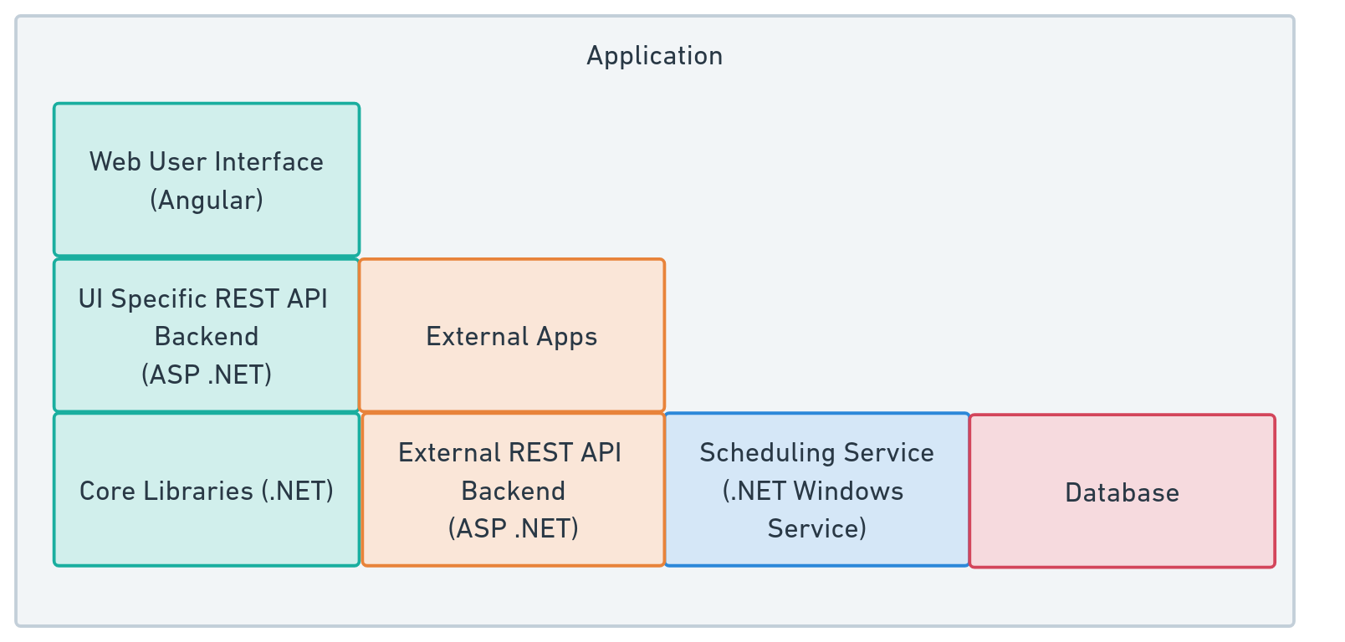
Application Architecture

Slide 73
Expand and Contract Pattern
Deployment #1 - Add ColourCode Column to DB
Deployment #4 - Remove ColourName column from DB
Deployment #2 - Update code to read / write to both columns
Deployment #3 - Remove code that writes to ColourName
Image Source: https://openpracticelibrary.com/practice/expand-and-contract-pattern/

Slide 74
Image Source: https://www.atlassian.com/continuous-delivery/principles/feature-flags

Slide 75
Architecture Changes
Feature flags for main application
Isolate those components
Fewer changes to deploy
Faster deployments
Quicker verification
Reduce common code
Reduce coupling between components
Changing a library doesn’t force redeployment

Slide 76
Goals Prioritization
Improve the flow of changes through Production
Automated deployment pipeline
Main is always in a shippable state
Reasonable decoupling
Learn about users
Faster Feedback
Shift steps to earlier in the pipeline
Monitoring and alerting
Iterate and Learn
Tighter integration with users

Slide 77
Don’t set goals and priorities in a vacuum

Slide 78
Faster feedback is a good thing

Slide 79
Understand your users and don’t discount their usage of the application

Slide 80


Thank you!
Bob Walker - Field CTO at Octopus Deploy
@bobjwalker
bob.walker@octopus.com
@bobjwalker

